Slide 1
Slovak Youth Institute
Youth Policy and Youth Participation
on Local Level

Slide 2
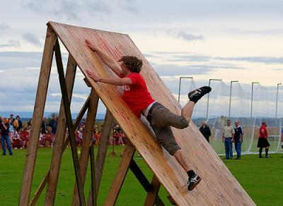
When Speaking about Youth Policy
YOUTH POLICY ≠ LEISURE TIME
YOUTH POLICY ≠ INTEREST CLUBS
YOUTH POLICY ≠ FORMAL EDUCATION
YOUTH POLICY ≠ SPORT

Slide 3
How to Create Conditions for Young People so They Use Their Talent and Potential?
Employment
YOUNG
PEOPLE
Social Inclusion
Health
Participation and Voluntarism

Slide 4
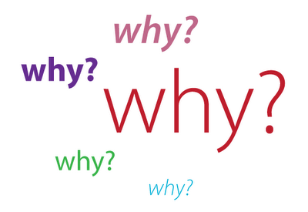
Why Should We Care for Young People?

Slide 5
Why Should We Care for Young People?
BECAUSE…
they will take care of me, when I will be old
they will vote for me in the election
they will contribute to my pension
they will by my product

Slide 6
Why Should We Care for Young People?
BECAUSE…
they will stay living and working in our town
they already have ideas how to do things differently
they have a lot of energy and no opportunities to use it
it is almost half of the Slovak population and they should have their rights
they believe to ideals and want to fulfill them

Slide 7
That’s Nice, but…

Slide 8
Youth in Action Programme
Among other activities
Supports development of youth policy and structured dialogue with young people

Slide 9
Meetings of Young People and those Responsible for Youth Policy
Provides space for discussion, active participation and information lineked to structured dialogue or European topics
Supports cross-sectoral dialogue

Slide 10
Youth Democracy Projects
Projects boosting active participation of youth
Provides young people with real-life experience with democracy and participation
Expects international “multi-partnership”

